Slide 1
CROP YILED PREDICTION and CROP RECOMMENDATION

Slide 2
ABSTRACT
The analysis focuses on predicting crop yield based on weather conditions, soil characteristics, and farming practices.
The dataset includes multiple crops across different states and seasons, considering factors such as area cultivated, production volume, annual rainfall, fertilizer use, and pesticide application.
Machine learning models will be employed to predict crop yield, helping optimize resource allocation and improve decision-making for sustainable farming.
The findings aim to enhance agricultural planning, and precision farming techniques.

Slide 3
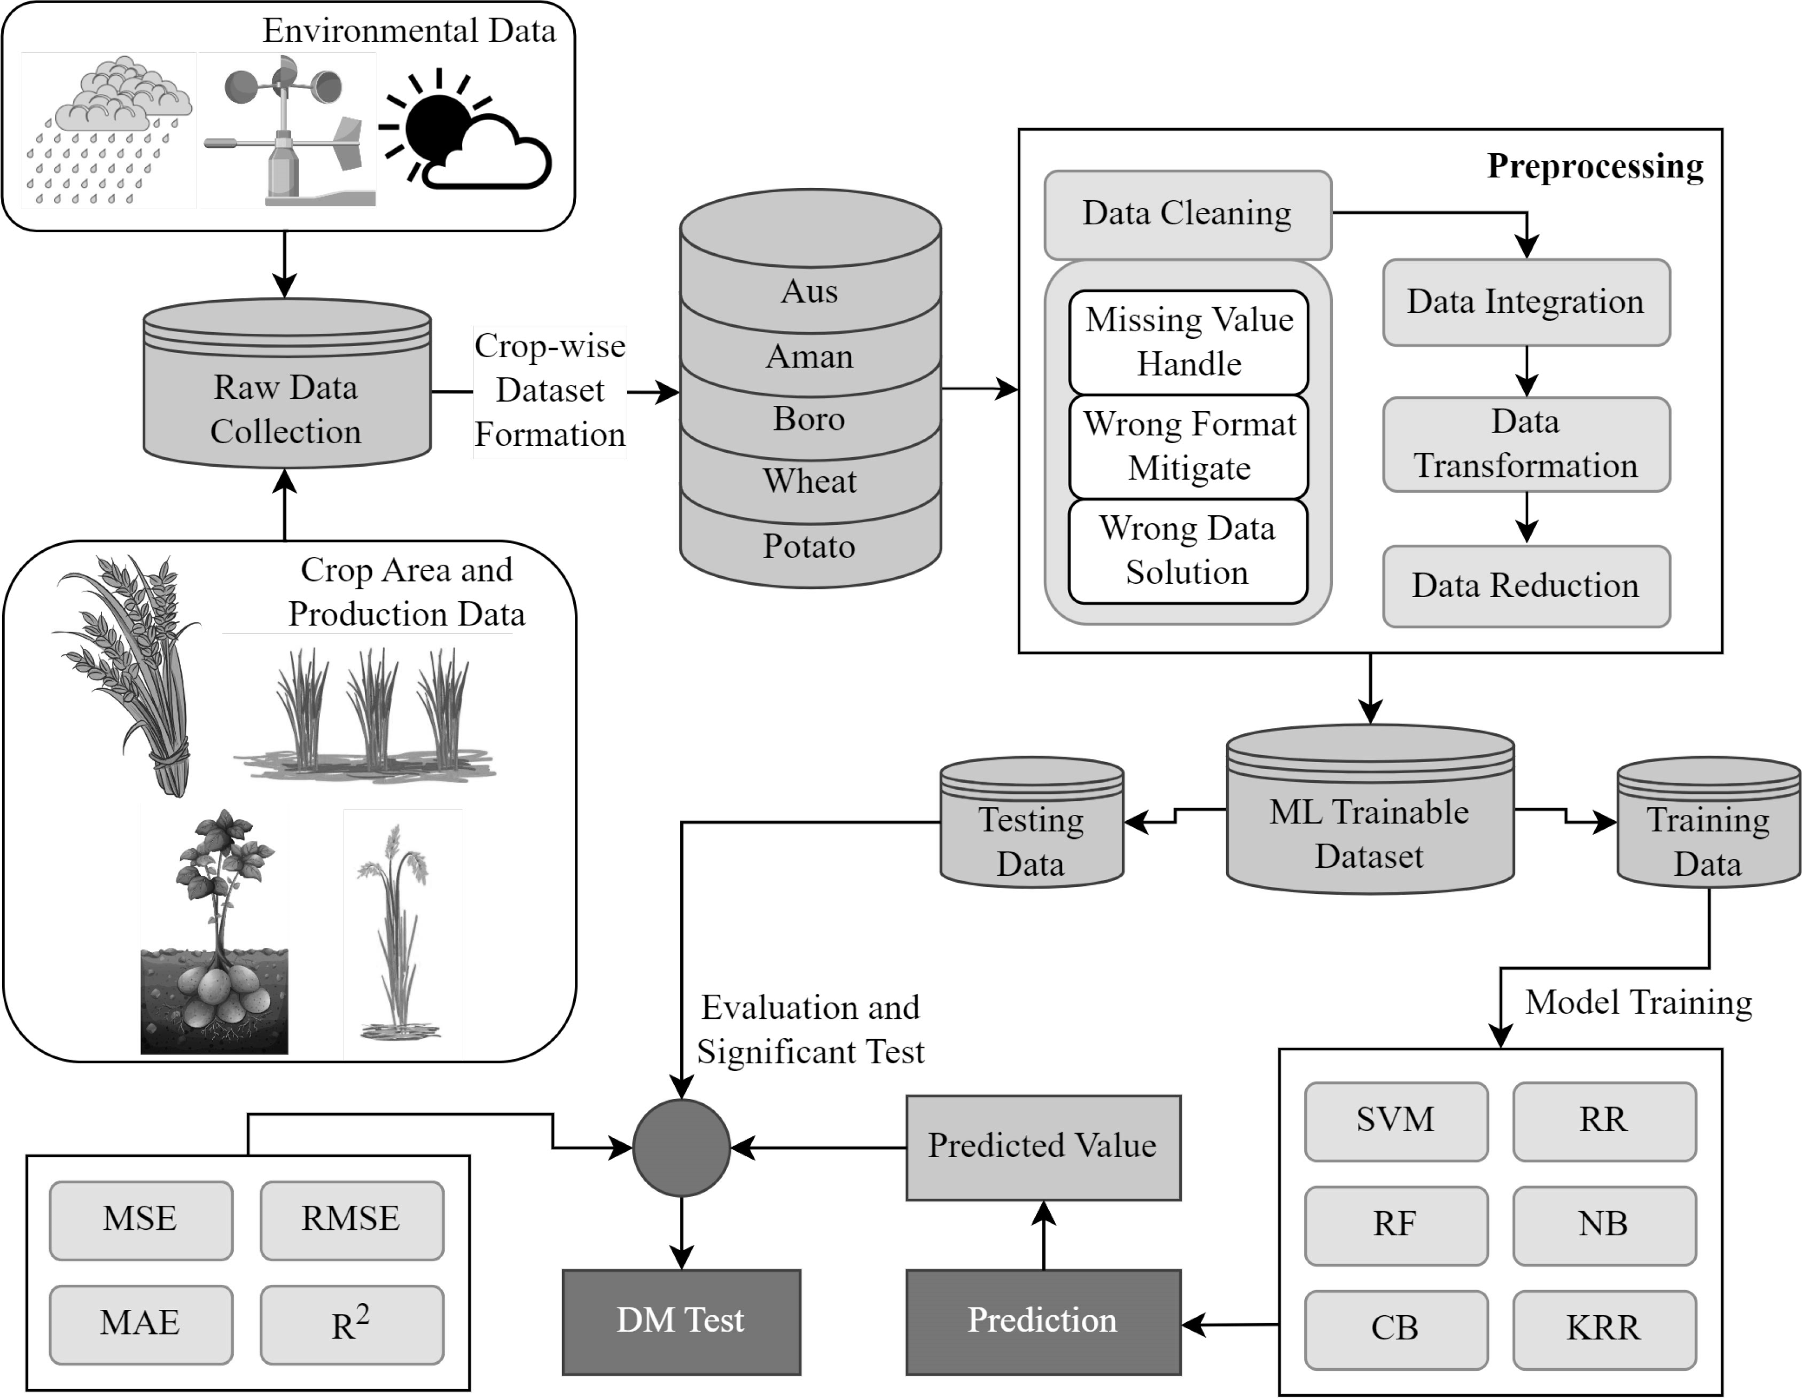
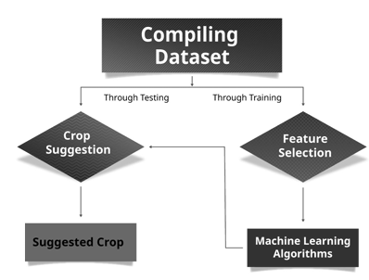
ARCHITECTURE FOR YIELD PREDICTION
CROP
Rice
Wheat
Maize
Sugarcane
Potato
Label Encoder
PREDICT THE YIELD PRODUCTION
Random Forest model
IN
TONS PER HECTARES
RANDOM FOREST REGRESSOR
RMSE
R^2
UI

Slide 4
ARCHITECTURE FOR CROP RECOMMENDATION
RANDOM FOREST CLASSIFIER

Slide 5
DATA PREPROCESSING
Handle Missing Data – Fill missing values using average (mean/median) or advanced techniques.
Select Important Features – Keep only the most useful data that affects crop yield.
Normalize Data – Scale numbers (e.g., rainfall, fertilizer) so they are in a similar range.
Convert Text to Numbers – Change crop names, seasons, and states into numerical values.
Balance the Data – Ensure fair distribution of all crops to avoid bias.
Split Data for Training & Testing – Use 70-80% of data for training and 20-30% for testing.
Reduce Complexity (if needed) – Simplify data using special techniques to make the model faster.

Slide 6
APPLY PCA FOR CROP YIELD PREDICTION
Standardize the Data – Normalize numerical features like rainfall, fertilizer, and pesticide.
Compute Covariance Matrix – Identify relationships between different features.
Find Principal Components – Extract new feature combinations that explain the most variance.
Select Optimal Components – Keep only the top components that retain maximum data information (e.g., 95% variance).
Transform Data – Convert the original dataset into the selected principal components.
Train the Model – Use the reduced dataset for crop yield prediction.

Slide 7
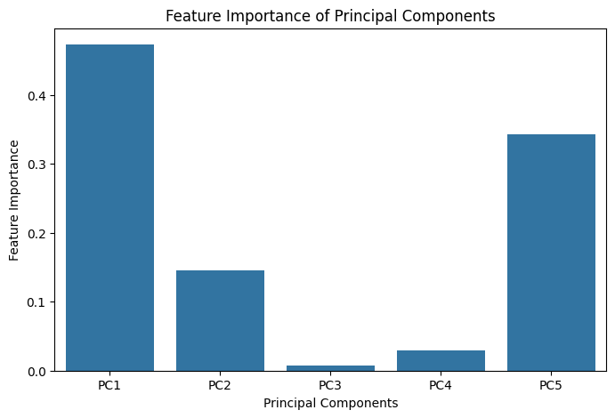
Shows the importance of each principal component in making predictions.

Slide 8
TRAIN & TEST THE MODELS
1. Data Splitting – 80% Training, 20% Testing. 2. Models Used – Random Forest Regressor (Best), SVR. 3. Input & Output – PCA-transformed data → Predicted Crop Yield. 4. Train Models – Fit models using training data. 5. Test Models – Evaluate using test data. 6. Best Accuracy – Random Forest Regressor (97%).

Slide 9
UI--STREAMLIT IMPLEMEMTATION
Install Streamlit → pip install streamlit pandas numpy joblib
Import Libraries → Load Streamlit, Pandas, NumPy, Joblib
Load Model → model = joblib.load("random_forest_model.pkl")
Create UI Input: Crop, Season, State, Year, Area, Production, Rainfall, Fertilizer, Pesticide Output: Predicted Crop Yield
Predict Yield → Process input and display the result
Run App → streamlit run app.py

Slide 10
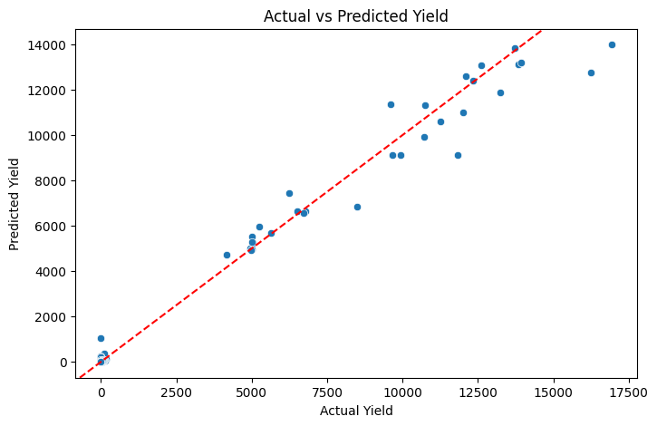
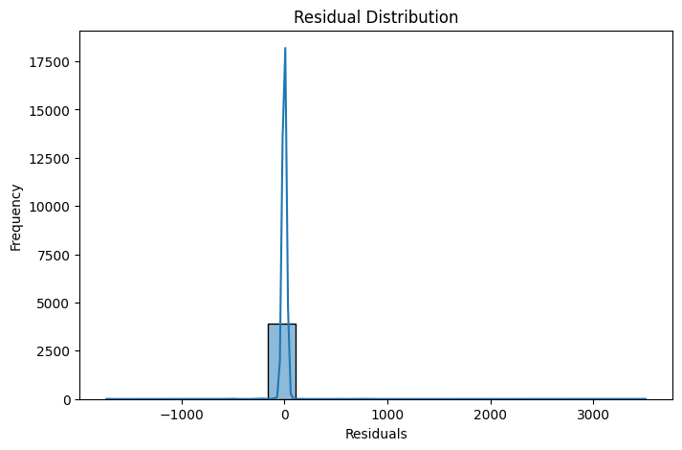
Helps assess how well the model's predictions
align with actual values.
Shows the distribution of errors
(difference between actual and predicted values).

Slide 11
Real-World Impact
Farmers → Higher yield & better crop choices Government & NGOs → Helps in agricultural planning & subsidies Agri-Tech Startups → Can integrate this into precision farming solutions Environmentalists → Reduces fertilizer overuse & improves sustainability

Slide 12
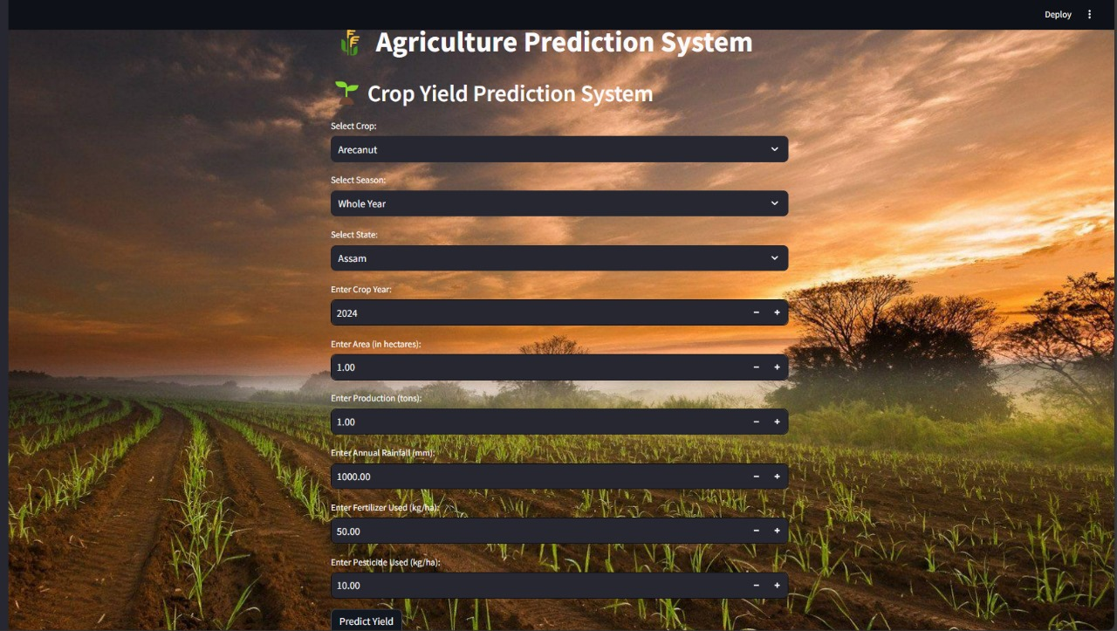
UI DESIGN

Slide 13
CONCLUSION
Crop yield predicted using machine learning
Random Forest Regressor gave the best accuracy (97%)
Streamlit used for easy user interface
Helps farmers in better crop planning
Can improve with real-time data in the future

